Slide 1
The Long Run Impact of Cash Transfers to Poor Families
Anna Aizer
Shari Eli
Joseph Ferrie
Adriana Lleras-Muney

Slide 2
Motivation
Early-life exposure to disease, nutritional deprivation and other factors associated with poverty have negative long-term effects of on educational attainment, labor market outcomes, and mortality.
In the United States, cash transfers to poor families were established primarily to help children. Means-tested cash transfers could fail to help poor children:
the amounts given may be insufficient
parents might not use the transfer in ways that benefit their children
The program could induce parental behavioral responses that are potentially detrimental to the child
Thus, it is unknown whether cash transfers provide lifelong benefits for children raised in poor families.

Slide 3
Aim of the study
The study estimates the long-run impact of cash transfers to poor families on children’s longevity, educational attainment, nutritional status, and income in adulthood.
Data: Mothers’ Pension program (1911-1935)
The intent of the MP program was to improve the conditions of “young children that have become dependent through the loss or disability of the breadwinner”
Data collected on over 16,000 boys from eleven states born between 1900 and 1925, most of whom had died by 2012.
Data also include information on thousands of accepted and rejected applicants

Slide 4
Mothers’ Pension Program
The MP program was a needs-based program, established on a state-by-state basis between 1911 and 1931.
When it was replaced by Aid to Dependent Children program (ADC) in 1935, 200,000 children were receiving MP benefits.
Main factor prompted the enactment of MP legislation was that MP programs were seen as a cheaper and better alternative for children since income transfers would allow mothers to care for their children at home.

Slide 5
Data and Sample Selection
The study uses approximately 80,000 child recipients whose mothers applied to the MP program between 1911 and 1935 in eleven states: Idaho, Illinois, Iowa, Minnesota, Montana, North Dakota, Ohio, Oklahoma, Oregon, Washington and Wisconsin.
Study keeps only male children (under age 18) born 1900-1925, whose mothers applied to the program prior to 1930. By imposing these restrictions, we have a sample of individuals who are most likely deceased by 2012 and who did not apply as a result of the Great Depression.
Only counties where data on rejected applicants are available is kept.
Each male child of every MP applicant was matched to records from the Social Security Death Master File (DMF)

Slide 6

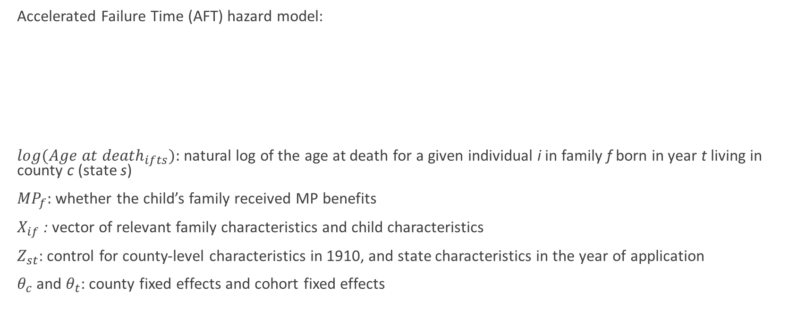
Basic Empirical Model
Accelerated Failure Time (AFT) hazard model:
$log{(Age at death}_{ifts}):$natural log of the age at death for a given individual i in family f born in year t living in county c (state s)
${MP}_{f}:$ whether the child’s family received MP benefits
$X_{if}$ : vector of relevant family characteristics and child characteristics
$Z_{st}$: control for county-level characteristics in 1910, and state characteristics in the year of application
$θ_{c}$ and $θ_{t}$: county fixed effects and cohort fixed effects

Slide 7

Model to Address Attrition and Multiple Matches
P is probability of surviving past age a for a given individual.
To investigate the role of attrition, it is assumed that all those without a match in the DMF were deceased by 1975.
Then compare survival regression results for the “matched sample” (where only those with unique ages at death are included) with results from the “full-sample” where they impute a zero to those without an age at death in all estimations.

Slide 8
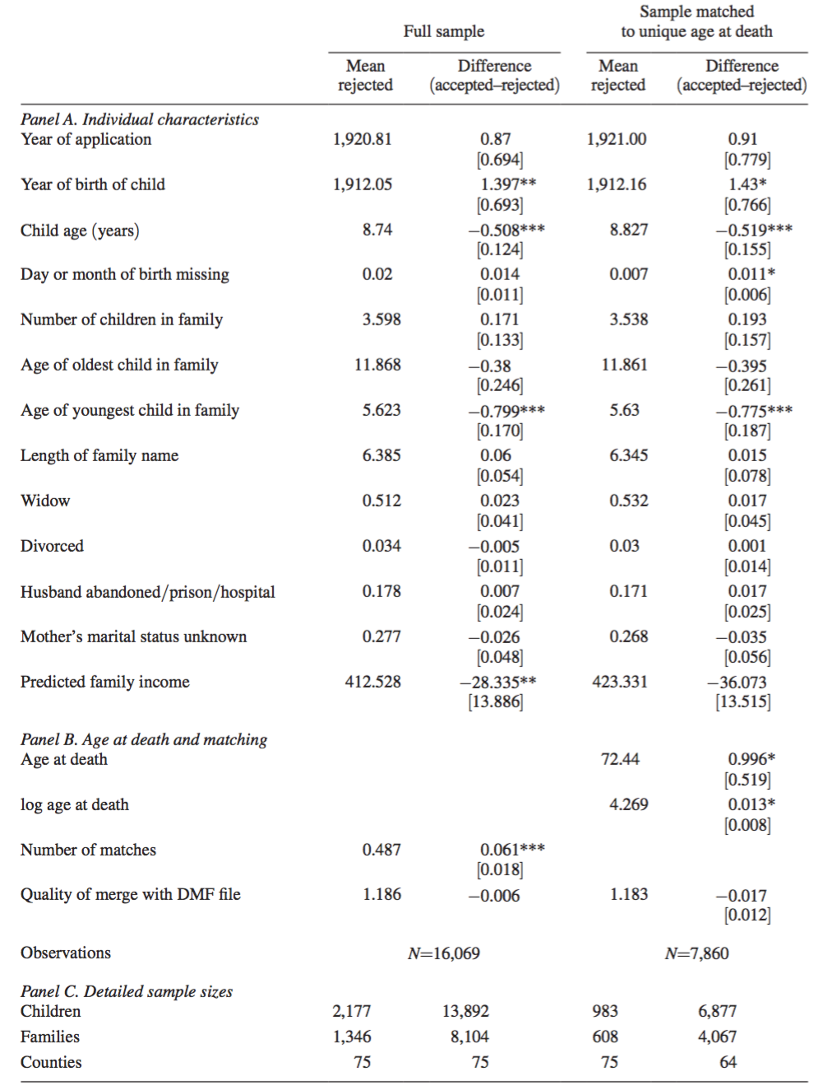
Evaluation of an identification strategy based on rejected applicants
Table shows sample size, about 16,000 males in 60 counties from eleven states. Among those, 14 percent were rejected applicants.
For identification of causal effects, they use rejected applicants as the counterfactual.
Accepted and Rejected applicants differ in Age, Family size, Widowhood and Income
Predicted family income shows that on average accepted applicants had 7–9 percent lower family incomes than rejected applicants.

Slide 9
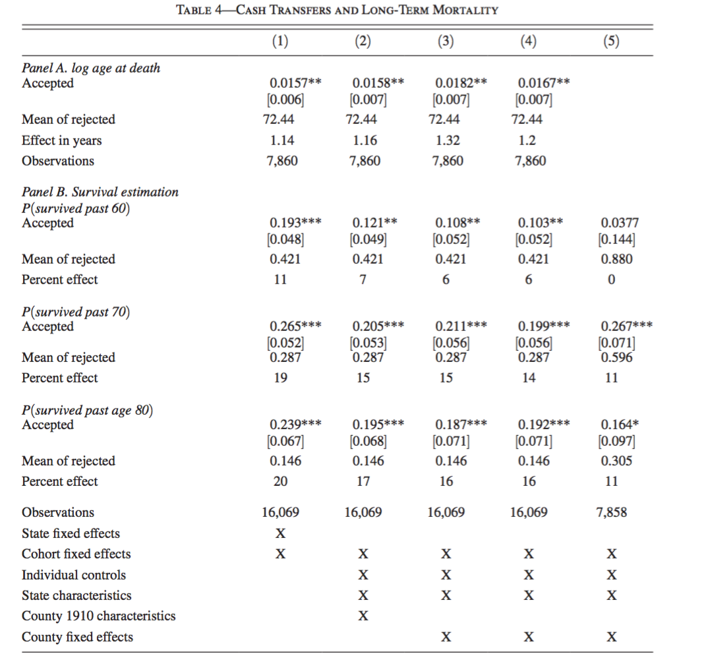
Mortality results
Panel A: Estimates of longevity
Column 1: State and cohort dummies
Column 2: Individual controls, county characteristics in 1910 and state characteristics at the time of application
Column 3: County fixed effects
Column 4: Date of birth form the death certificate instead of the date on the MP application.
Acceptance increased life expectancy by about a year, relative to a mean of 72.5, among the rejected. The estimates range from 1.1 to 1.3 years of life depending on the specification and sample.
Panel B: Assesses the role of attrition

Slide 10
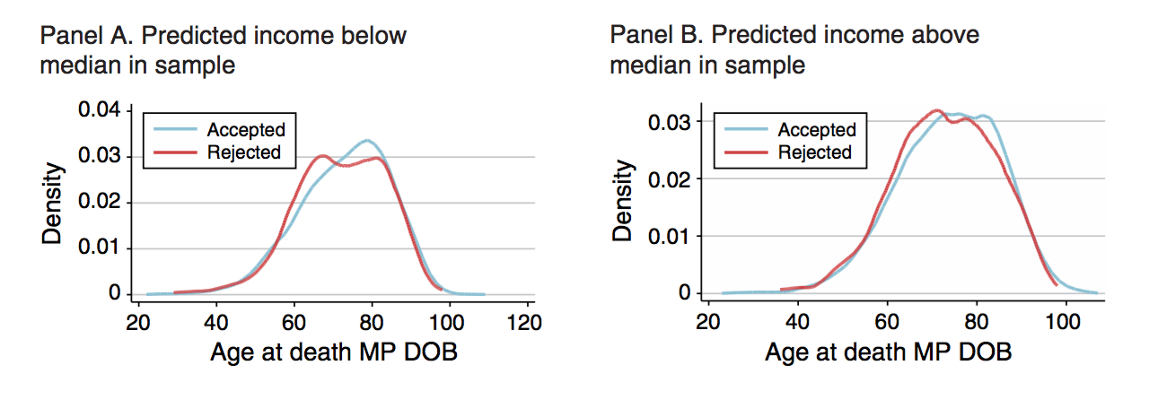
Mortality Results Heterogeneity by Income

Slide 11
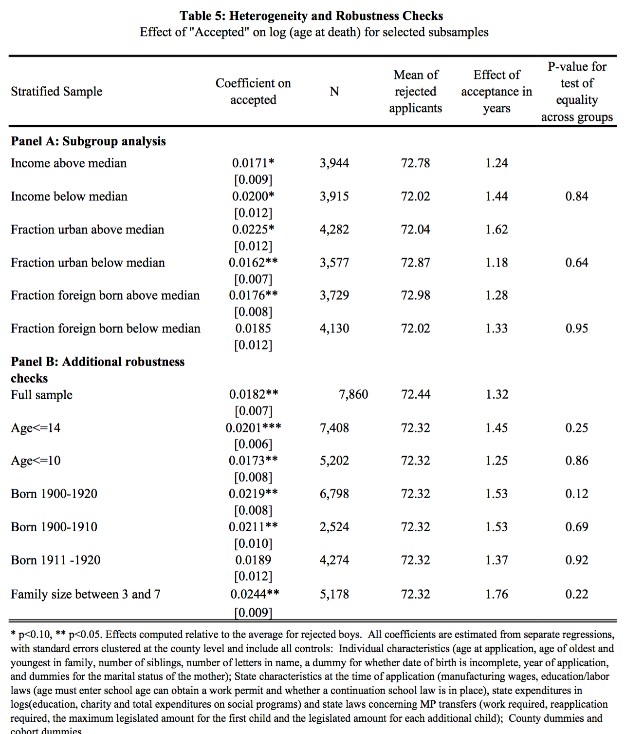
Heterogeneity by Income and Urban Residence
The effect of the MP program is larger among the poorest in the sample.
Income below the median:
MP program acceptance increases longevity by 1.44 years
Income above the median:
MP program acceptance increases longevity by 1.24 years
The effect of MP program is also larger among young children:
Children under 10 are 17–18 percent more likely to survive past age 70 than their rejected counterparts, relative to 11 percent for children aged 10–14.

Slide 12
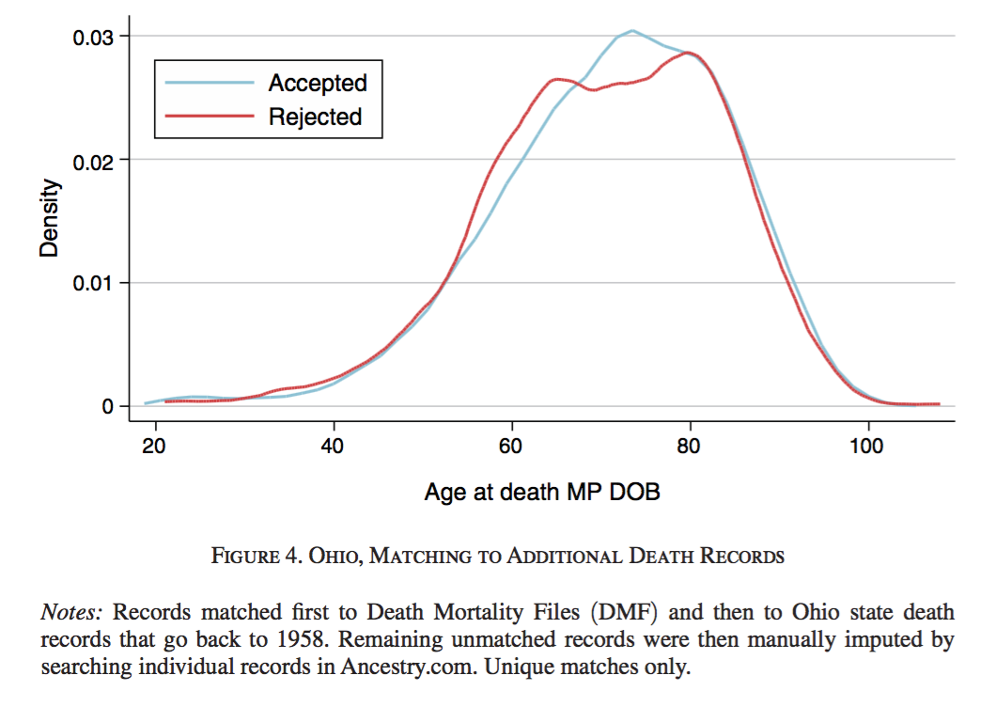
Mortality Results Estimates for Ohio

Slide 13
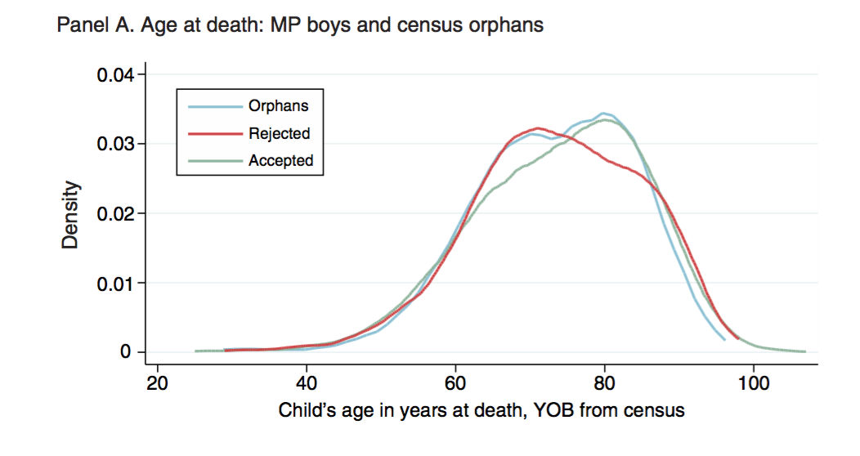
Mortality Results Alternative Counterfactuals

Slide 14
Results for Educational Attainment, Health, and Income in the Medium-Term
Previous work has shown education, income, and weight (being underweight, in particular) are strongly associated with mortality (Flegal et al. 2005; Deaton and Paxson 2001; Cutler and Lleras-Muney 2008).
The study estimated the effect of the MP program on these possible medium-term (adulthood) outcomes by linking the MP sample to 1940 census and WWII enlistment records.
By matching MP applicants to 1940 census data, they examine the impact of MP receipt on educational attainment and income during young adulthood.

Slide 15
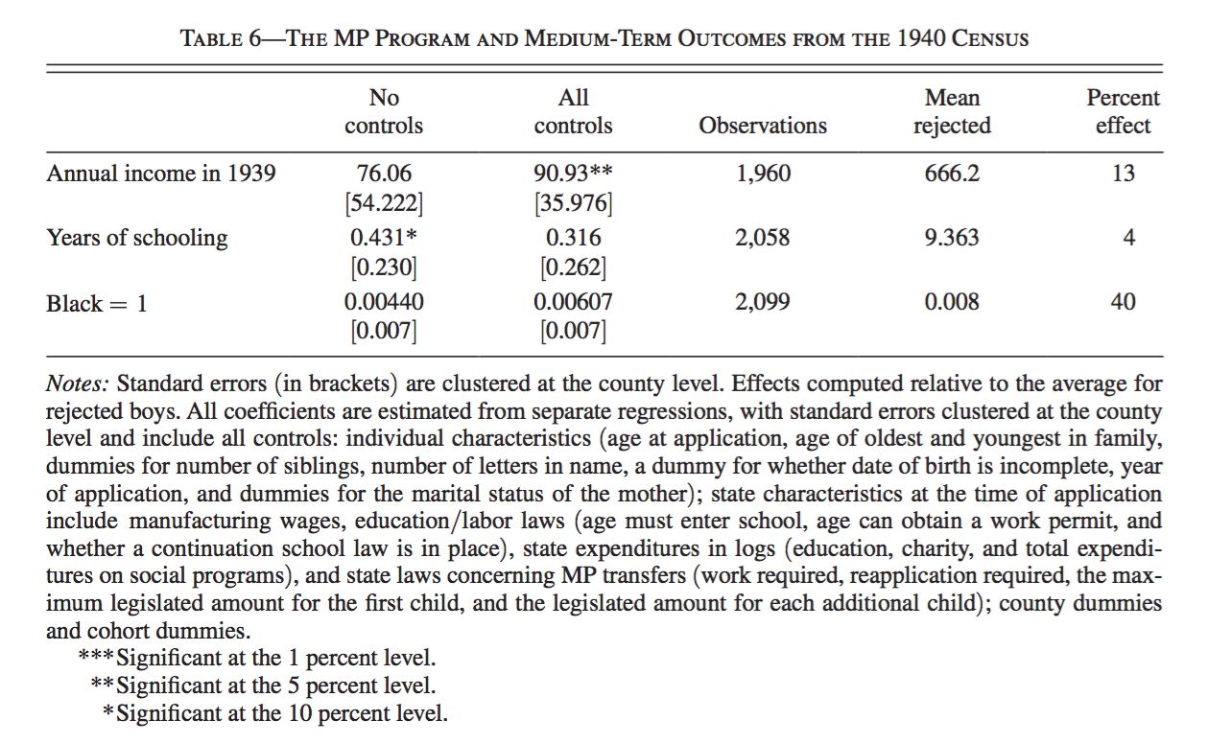
MP recipients on average have incomes that are 13 percent higher than their rejected counterparts in 1940.
MP receipt results in 0.4 more years of schooling.

Slide 16
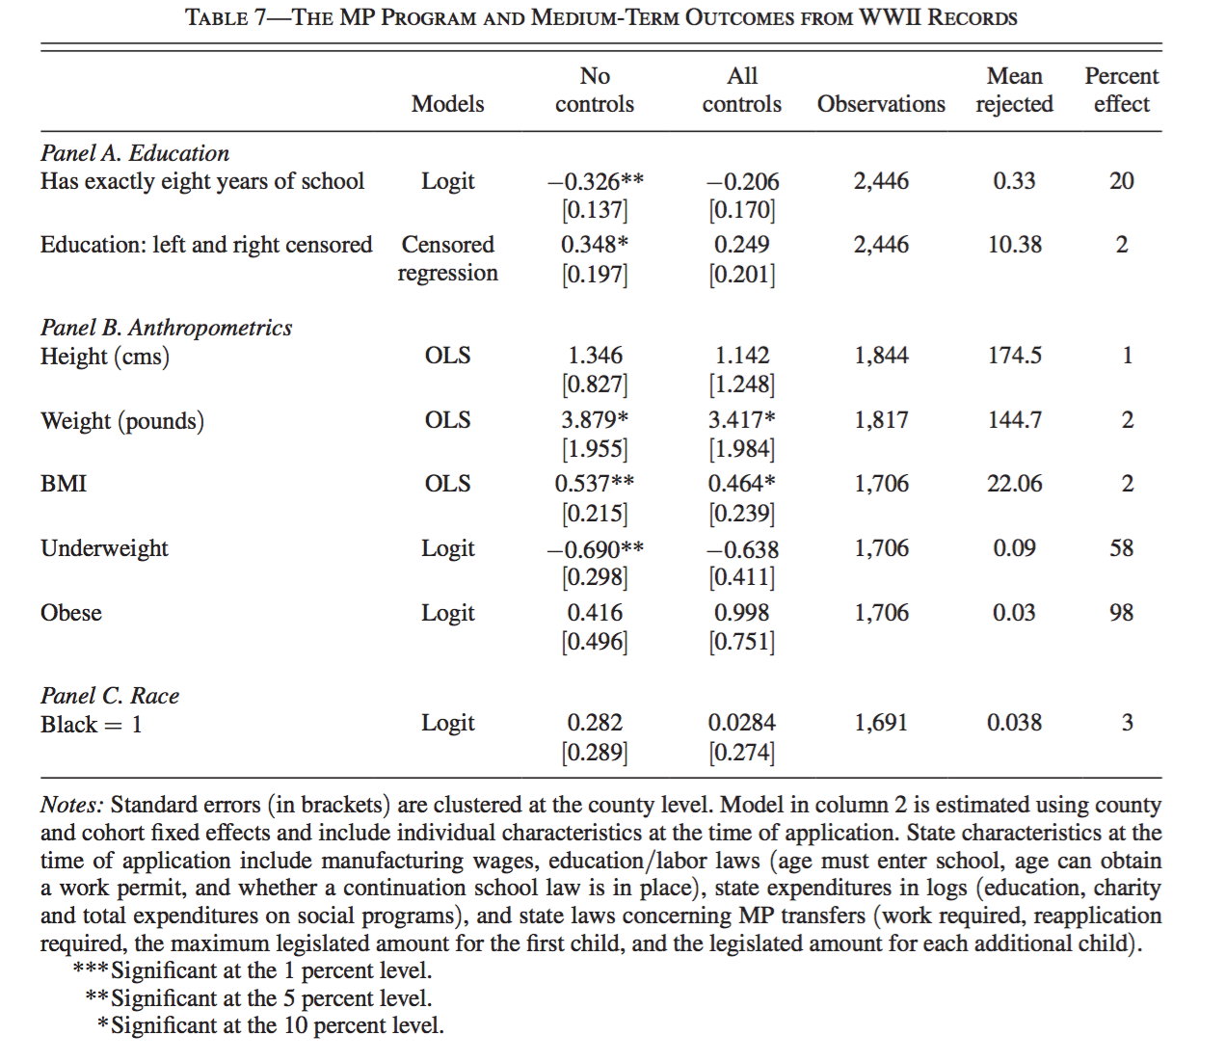
Impact of MP receipt on educational attainment and income during young adulthood (WWII Enlistment Records)
Children of accepted families are 20 percent more likely to have more than eight years of school.
MP recipients complete a third of a year more school than rejected applicants
Table shows statistically significant 50 percent reduction in the probability of being underweight.
Transfers helped families improve the nutrition of their children

Slide 17
Conclusion
Using data collected on over 16,000 boys from 11 states, who were born between 1900 and 1925, and whose mothers applied to the Mothers’ Pension program, study found that receiving cash transfers increased longevity by about 1 year. This effect is greater for the poorest families in the sample: their longevity increased by 1.5 years of life.
To investigate potential mechanisms behind the positive effect on longevity, study match a subset of its records to WWII enlistment and 1940 census records. The results suggest that MP program resulted in a significant 50 percent decrease in under-nutrition, a 13 percent increase in income, and an increase of 0.4 years of school among young adults.

